Slide 1

Cyber Kill Chain
Submitted by
Arathy v j

Slide 2
Introduction
what is cyber kill chain?
The cyber kill chain is a series of steps that trace stages of a cyberattack from the early reconnaissance stages to the exfiltration of data. The kill chain helps us understand and combat ransomware, security breaches, and advanced persistent attacks (APTs).
The term "kill chain" originates from military tactics and refers to the sequence of events necessary to successfully complete a mission. In the context of cybersecurity, the Cyber Kill Chain outlines the stages an attacker typically goes through to achieve their objectives, whether it's stealing sensitive information, disrupting operations, or causing other forms of damage.

Slide 3
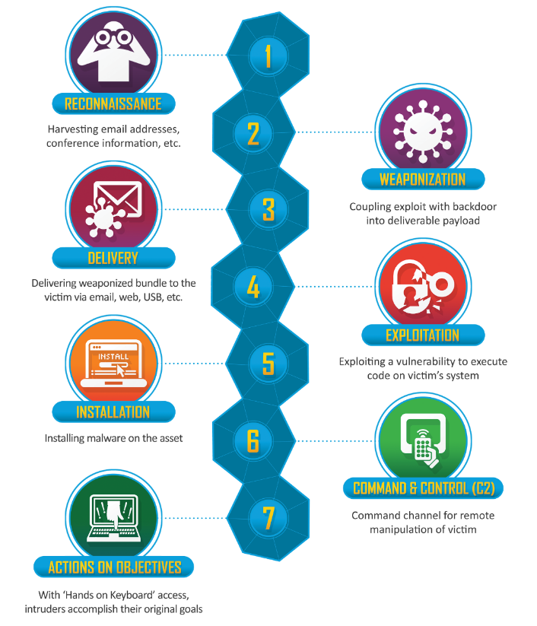
stages of the Cyber Kill Chain

Slide 4
Reconnaissance: Gathering information about the target, such as identifying potential vulnerabilities, system configurations, and employee information.
Weaponization: Developing or acquiring the tools and malware necessary to carry out the attack. This stage involves creating malicious payloads or weaponizing legitimate software.
Delivery: Sending the weaponized payload to the target. Common delivery methods include email phishing, compromised websites, or exploiting software vulnerabilities.
Exploitation: Exploiting vulnerabilities in the target system to gain unauthorized access. This could involve leveraging software vulnerabilities, weak passwords, or misconfigurations.
Installation: Installing malware or establishing footholds within the compromised system to maintain access and persistence.

Slide 5

Command and Control (C2): Establishing communication channels between the attacker and the compromised systems. This allows attackers to remotely control and manage their malicious activities.
Actions on Objectives: Finally, the attacker
executes their intended actions, which
could include stealing
data, disrupting operations, or
causing other forms of damage.

Slide 6
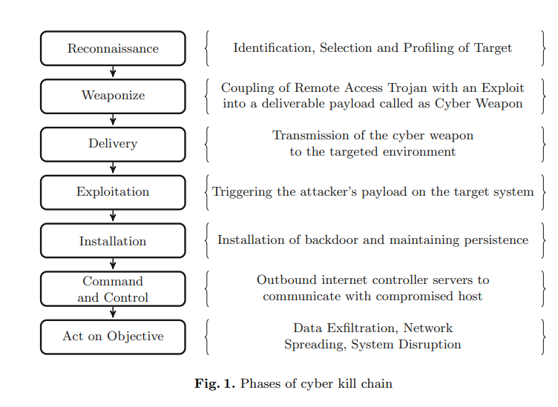

Slide 7
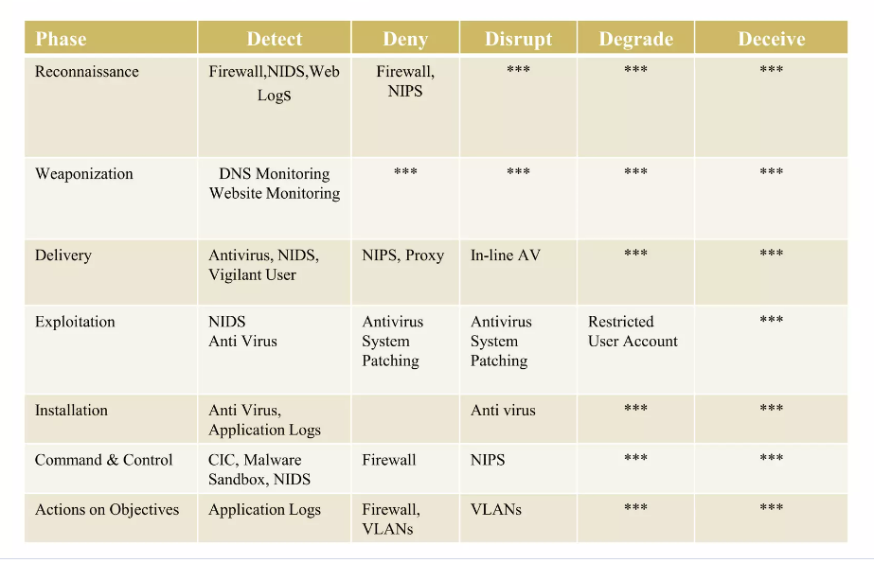
COURSE OF ACTION

Slide 8
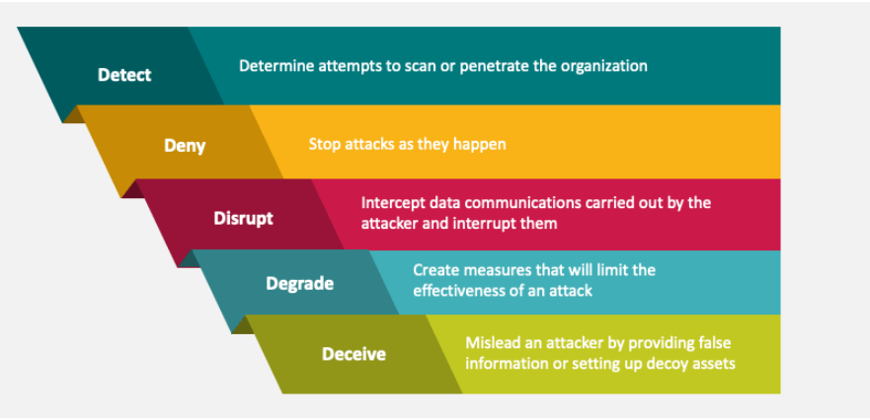
Security controls
Security controls use to stop cyber kill CHAIN

Slide 9
Conclusion
Cyber kill chain is a model for incident response teams, digital forensic investigators and malware analysts to work in a chained manner. Inherently understanding, Cyber kill chain is modeling and analyzing offensive actions of a cyber attacker . So, for a security analyst who develops defensive counter measures , it is of utmost importance to study the cyber kill chain. This knowledge can help one think on the same lines of that of an attacker. Each phase of the kill chain in itself is a vast research area to tackle and analyze.
The Cyber Kill Chain consists of multiple stages, including reconnaissance, weaponization, delivery, exploitation, installation, command and control, and actions on objectives. Each stage represents a distinct phase of an attack, and understanding these stages allows organizations to implement effective security measures to mitigate cyber risks.

Slide 10
THANK YOU

